Slide 1




Constructing Synthetic Controls in R

Slide 2
Synth Package in R
Alberto Abadie, Alexis Diamond, Jens Hainmueller (2011). Synth: An R Package for Synthetic Control Methods in Comparative Case Studies. Journal of Statistical Software, 42(13), 1-17. URL http://www.jstatsoft.org/v42/i13/.
Constructs a synthetic control county that weights donor control data to approximate the intervention county’s predictors and outcome prior to the time of intervention
Install with install.packages(“Synth”)
Notes:
In this part, I’m just going to run through the code with some very very basic dummy code so that when you open up the R file to look through a more complicated dataset, you can navigate it a little bit easier. I’m just going to show you the major functions of the code and what they do.

Slide 3
Data
id | county | study_time | outcome | predictor 1 | predictor 2 | predictor 3 | predictor 4 | predictor 5 | predictor 6 | predictor 7
1 | Intervention | … | … | … | … | … | … | … | … | …
1 | Intervention | -3 | 300 | 109 | 10 | 56 | 9 | 20 | 2 | 1
1 | Intervention | -2 | 310 | 109 | 10 | 56 | 9 | 20 | 2 | NA
1 | Intervention | -1 | 312 | 109 | 10 | 56 | 9 | 20 | 2 | NA
1 | Intervention | 0 | 320 | 112 | 12 | 52 | 7 | 22 | 1 | NA
1 | Intervention | 1 | 322 | 112 | 12 | 52 | NA | 22 | 1 | NA
1 | Intervention | 2 | 323 | 112 | 12 | 52 | 7 | 22 | 1 | NA
1 | Intervention | 3 | 325 | 110 | 9 | 50 | 8 | 24 | 2 | NA
2 | Control 1 | -9 | 275 | 87 | NA | 41 | 8 | 19 | 3 | NA
2 | Control 1 | -8 | 277 | 87 | NA | 41 | 8 | 19 | 3 | NA
Notes:
Dataset you have is in a long format, with one row per county per time point. Variables we have include:
Unique ID of the county
County name
Study time, with -9 being our first time of observation, 0 being the time of intervention, and 3 being the last time of observation.
An outcome variable that changes at every time point
A number of predictor variables that mostly change after 3 time periods, so say we measure this every quarter. However, predictor 7 is only measured once, at time -3, which lets say happens for every county. We account for this in the code and in the code you receive, you’ll also see a variable measured once every 10 years rather than annually.
Throughout the dataset, we have a little bit of missingness. One of the great things about the synthetic control method is that we don’t necessarily need to worry about this unless there is a really substantial amount of missingness. The algorithm will simply account for missingness when its building the synthetic control county.

Slide 4
dataprep ()
To build the synthetic control, we first use the dataprep() function to create an object that the synth() function can use to construct synthetic controls
Information we feed to the function:
Time
Predictors
Outcome
Identifiers
Notes:
To build the synthetic control, we’ll use the dataprep function to create an object that the synth function can use to construct synthetic controls. On the next slide I have the entire dataprep function written out, which you’ll also work with on your own to get even more practice. But really, all the function needs is four bits of information. It needs to know:
Time: what is the time period before the intervention where we want our outcome trend to look as similar as possible? How long after that should we make predictions for the synthetic control county’s outcome data?
Predictors: what predictors of the outcome do we want to consider when building our synthetic control? Maybe we think the gun ownership rate, vaccination rate, urbanicity or rurality, proportion of the population under 18, whatever else is associated with the outcome we’re interested in, so we want to create a synthetic county that has values for these predictors that are similar to the intervention county.
We need to know what the outcome variable is
And finally we need to tell it which county is the intervention county and which counties we want it to consider to be in the donor pool for constructing the synthetic control

Slide 5
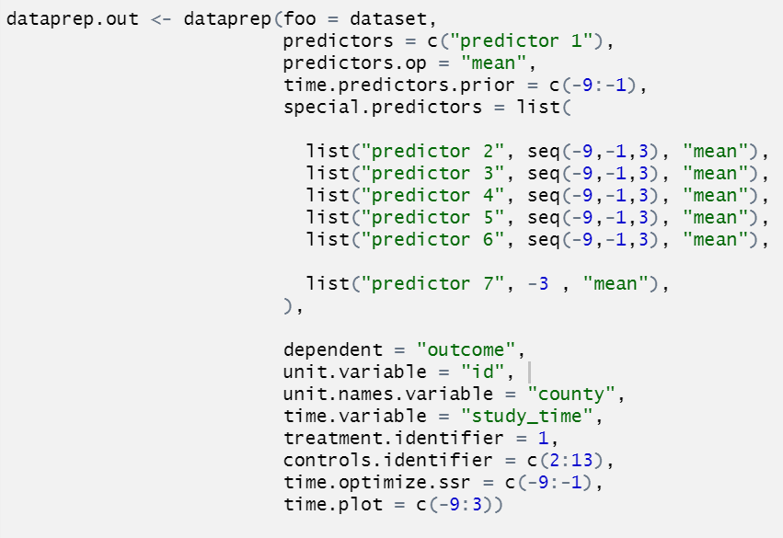
dataprep()
Time
Predictors
Outcome
Identifiers
Notes:
Here is what the dataprep object looks like. After specifying the dataset in the first line, we address each of these elements.
We specify the time period for maximizing fit of the predictors in time.predictors.prior and of the outcome in time.optimize.ssr. In both cases, we are saying we want to maximize the fit from the first observation at time -9 to the month before intervention, time -1.
We need to tell it what the name of the time variable is
And we need to tell it how long the entire period is for producing synthetic control outcome data. So here the entire period is from -9 to 3.
There are two different predictors here, regular predictors and special predictors. The algorithm does not weight or otherwise treat predictors and special predictors differently, but special predictors allows you to specify how data that is recorded annually instead of monthly or only once every 3 months or only once a year should be treated.
Predictors here assumes every time period, which works great if you have data that changes or at least is present at every time period. Under predictors.op we are specifying that we want it to find a mean value from the donor control pool that fits best, but we can also specify median or other operators.
Under special predictors, we name the predictor and then describe its sequence. For predictors 2 through 6, we are saying that the data is recorded every 3 months during the pre-intervention period from -9 to -1. Still taking the mean.
For predictor 7, we know that this is only recorded at time -3 for every county. So we want it to find a comparable mean value just for that time period.
We need to tell it what the name of our outcome variable is here under dependent, we just called it outcome
And then finally we need to give it some identifiers.
The numeric identifier is called “id” and we name it under unit.variable
The name identifier is called “county” and we name it under unit.names.variable
And then we tell it that the identifier of the intervention or treatment county is 1 and the identifiers of the control counties are 2 through 13.

Slide 6
Create the synthetic control!
Notes:
Now that we’ve made this dataprep object with all of the information it needs, we can put it into the synth function and let it construct the synthetic control county. When you do this, you’ll probably get a LOT of output, some of which isn’t helpful, like letting you know where all of the missing values were in the dataset. There is code in your example that I’ll touch on here that will help you pull out the pieces of information that you need to understand and use your synthetic control.

Slide 7
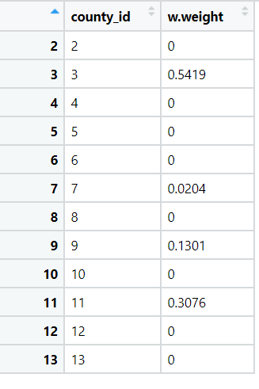
Weights information
Notes:
This bit of code will create a table that shows how much data was used from each county to construct your synthetic control.
Here is a really good place to check to see if using this synthetic control is really going to add much to your analysis. Sometimes you might find that 98% of your data is being drawn from one particular county, or 50% from one and 50% from the other. If that’s the case, using the synthetic control isn’t going to give you any more information than just using those one or two heavily-weighted counties as controls directly. Seeing that your synth function has drawn data from many different counties to differing degrees means that its doing something that you might not has been able to do manually.

Slide 8
Outputting the outcome values
study_time | intervention | path.case | path.synth
-3 | 300 | 300 | 300
-2 | 310 | 310 | 309
-1 | 312 | 312 | 313
0 | 320 | 320 | 313
1 | 322 | 322 | 314
2 | 323 | 323 | 313
3 | 325 | 325 | 315
Notes:
This bit of code will help you draw out the intervention county’s outcome data and the new synthetic control’s outcome data so that you can use it for time series analysis. It will produce two paths, the path.case being the intervention outcome and the path.synth being the synthetic control outcome. You should be seeing that the intervention outcome data from your original dataset is exactly the same as your path.case data! The only new information here is in the path.synth column.

Slide 9
Format from wide to long and add variables for analysis
study_time | outcome | group | policy | posttime | group_time | group_policy | group_posttime
-3 | 300 | 1 | 0 | 0 | -3 | 0 | 0
-2 | 310 | 1 | 0 | 0 | -2 | 0 | 0
-1 | 312 | 1 | 0 | 0 | -1 | 0 | 0
0 | 320 | 1 | 0 | 0 | 0 | 0 | 0
1 | 322 | 1 | 1 | 1 | 1 | 1 | 1
2 | 323 | 1 | 1 | 2 | 2 | 1 | 2
3 | 325 | 1 | 1 | 3 | 3 | 1 | 3
-9 | 290 | 0 | 0 | 0 | 0 | 0 | 0
… | … | … | … | … | … | … | …
3 | 315 | 0 | 1 | 3 | 0 | 0 | 0
Notes:
There are more steps in the notebook you’ll be working with to help you format the data for use in time series analysis, like Julie described earlier. So I’m not going to go into a lot of detail about that variable construction because she is definitely better versed in it than I, but at the end of the day you should have a dataset that looks like this in structure, ready for analysis.

Slide 10
Questions?
Notes:
You’ll have a chance to go through another version of this code on your own and see it working in action, but does anyone have any questions about it right now before we discuss our results with the real data?

Slide 11
Building our synthetic control with real data
Built the synthetic county using demographic and other data that predict domestic violence and how it is responded to
Population size, sex and race makeup, median household income, and percent of the population over age 25 with a bachelor’s degree or higher
Male unemployment rate, total unemployment rate, and the female-to-male unemployment ratio
Percent of county population living in a census-designated rural area
Sworn police officers per 100,000 population
Alcohol outlet density
Opioid overdose deaths
Notes:
We built the synthetic county using demographic and other data that predicts domestic violence and how it is responded to. In terms of demographics, we wanted to build a synthetic county that was demographically similar to our intervention counties, so similar size, sex and race makeup, median household income, and educational level, which we measured as percent of the population over age 25 with a bachelor’s degree or higher
We examined unemployment rates including male unemployment rate, total unemployment rate, and female-to-male unemployment ratio, as these are associated with intimate partner violence
We included the percent of county population living in a census-designated rural area – if our intervention counties were mostly urban, we didn’t want to wind up with very uncomparable rural counties as our control group
Finally, we included sworn police officers per 100,000 population, which could be related to how quickly domestic violence protection orders are serviced.
There are two variables that we wanted to include but couldn’t. One is alcohol outlet density, which we just don’t have the data for yet but hope to include later. However, the other is opioid overdose deaths, and we had to exclude it due to missingness.
While the algorithm can deal with data missingness to some extent, there comes a point where either it will not converge because there is too much missingness or it simply isn’t helpful to include it, as you can’t build comparable counties with sparse data. Because North Carolina has so many counties, opioid overdose death data can be sparse, particularly for smaller counties.
I note this because this is definitely something to watch out for and keep in mind. Throwing more data into the algorithm to build a better synthetic control is helpful, but it can only do so much.

Slide 12
Synthetic control weighting vs. manual control selection in DVPO granting rate
Pooled Control
Brunswick
Buncombe
Cabarrus
Caldwell
Harnett
Iredell
Johnston
Mecklenburg
Nash
New Hanover
Randolph
Robeson
Rockingham
Surry
Union
Wayne
Wilkes
Synthetic Control
Buncombe (10.11%)
Cabarrus (0.01%)
Carteret (0.01%)
Catawba (15.07%)
Chatham (0.34%)
Craven (5.50%)
Dare (0.13%)
Hoke (16.93%)
Jackson (4.24%)
Mecklenburg (21.63%)
Moore (0.01%)
New Hanover (14.08%)
Pitt (4.83%)
Union (6.96%)
Notes:
Because the synthetic control procedure is attempting to build a synthetic county that closely matches the intervention county on these various measures, the counties that were selected for their trend fit prior to intervention in previous analyses were not necessarily the same counties that ended up being weighted in the synthetic control. For example, in DVPO granting rate, we see that a few of the counties that were selected by hand for the pooled control were also included in the synthetic control and weighted fairly heavily. However, there are a lot of counties that were hand-selected that weren’t weighted in the synthetic control at all, and vice versa. That doesn’t meant that the synthetic control has gone wrong! Only that including predictors as well as pre-intervention outcomes changes what is “best” in terms of a control group.

Slide 13
Synthetic control weighting vs. manual control selection in involuntary dismissal
Pooled Control
Brunswick
Caldwell
Catawba
Gaston
Granville
Lincoln
Mecklenburg
Pitt
Randolph
Sampson
Union
Synthetic Control
Burke (26.55%)
Carteret (5.82%)
Catawba (0.17%)
Chatham (9.66%)
Craven (3.6%)
Dare (0.07%))
Hoke (0.02%)
Mecklenburg (23.76%)
New Hanover (29.42%)
Pitt (0.08%)
Union (0.84%)
Notes:
As another example, here are the counties hand selected and weighted in the synthetic control for involuntary dismissal. A few of them appear in both, but the inclusion of predictors has changed things.

Slide 14
Results

Slide 15

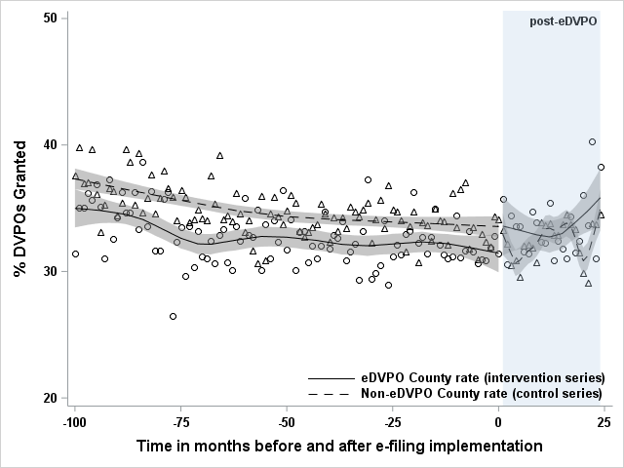
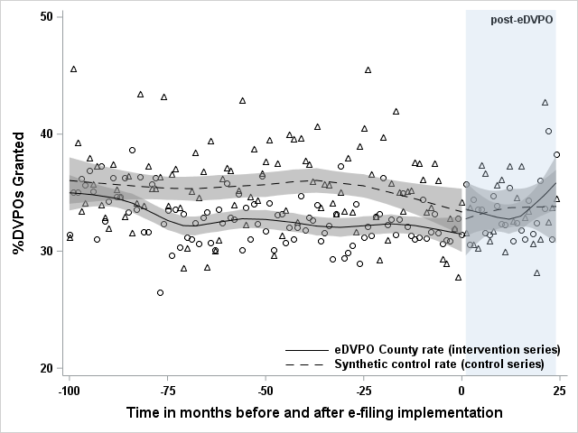
DVPO granting: No significant changes
CITS results
Immediate change: 2.27 percentage point increase (-0.16, 4.71)
Sustained change: 0.01 percentage point increase (-0.14, 0.17)
DiD results
Overall change: 3.05 percentage point increase (1.74, 4.32)*
SCITS results
Immediate change: 2.86 percentage point increase (-0.88, 6.60)
Sustained change: 0.01 percentage point increase (-0.19, 0.29)
SC-DiD results
Overall change: 2.56 percentage point increase (0.73, 4.41)*
Notes:
Here we have our original CITS and DiD results that were done with the pooled controls but now we can compare them to the results we achieved with the synthetic control.
First with DVPO granting rate. Looking back at our CITS results, we saw that there was an immediate increase in DVPO granting but no sustained change.
Unlike the pooled control series, the synthetic control series isn’t quite as jumpy after the intervention time, but our conclusions are similar.
Despite an immediate increase, things dipped down to where they should be.
If we were to only look at the DiD results, we would conclude that there was only this large increase. It isn’t as extreme in the SC-DiD results, probably because our trend line for the synthetic control is a bit smoother, but we would still come to the wrong conclusion. Using synthetic control does not eliminate the problem of drawing incorrect conclusions due to DiD.

Slide 16
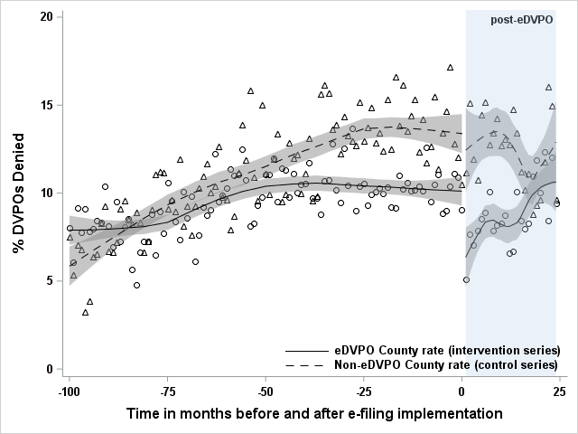
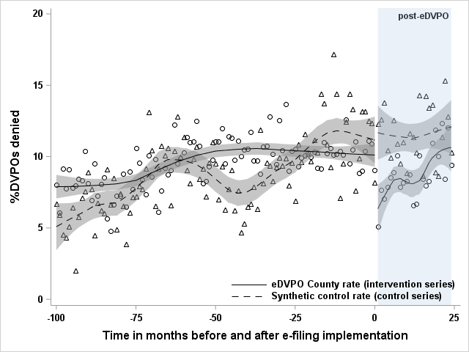
DVPO denials: Immediate decrease, sustained (small) increase
CITS results
Immediate change: -2.63 percentage point decrease (-4.74, -0.52)*
Sustained change: 0.29 percentage point increase (0.16, 0.43)*
DiD results
Overall change: -2.04 percentage point decrease (-3.49, -0.60)*
SCITS results
Immediate change: -4.11 percentage point decrease (-6.40, -1.82)*
Sustained change: 0.17 percentage point increase (0.02, 0.32)*
SC-DiD results
Overall change: -3.49 percentage point decrease (-4.83, -2.14)*
Notes:
For DVPO denials, we saw a large immediate increase, but again this was not sustained over time and we see that in both the CITS and the SCITS results. We can see here that in fact using synthetic controls for a DiD analysis make convince us even more of an effect – the SC-DiD point estimate is even lower and the confidence intervals are further from the null. We might look at that and say, wow, when we used a synthetic control, we strengthened our conclusion that e-filing reduces denials! However, the using the synthetic control has not changed the key issue with the DiD model, which is that it does not account for changes in trend.

Slide 17
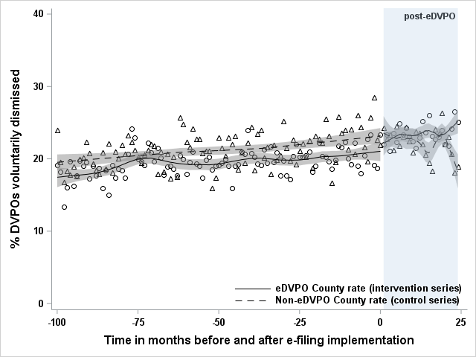
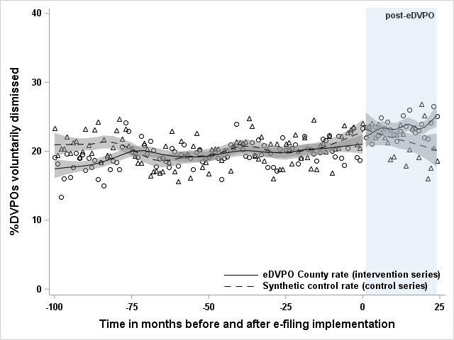
Voluntary dismissals: Sustained (small) increase
CITS results
Immediate change: 0.96 percentage point increase (-1.51, 3.42)
Sustained change: 0.19 percentage point increase (0.03, 0.35)*
DiD results
Overall change: 2.90 percentage point increase (1.60, 4.19)*
SCITS results
Immediate change: -1.17 percentage point increase (-3.69, 1.35)
Sustained change: 0.19 percentage point increase (0.03, 0.35)*
SC-DiD results
Overall change: 2.58 percentage point increase (1.31, 3.85)*
Notes:
For voluntary dismissals, we see something a little bit different. While the CITS showed a small immediate increase, the SCITS showed a small immediate decrease. However, these trend lines were very very close to one another prior to intervention, and both of our confidence intervals here include the null by a wide margin. Despite this, the SCITS model still shows the sustained small increase in voluntary dismissals after intervention, with point estimates and confidence intervals that look identical to the CITS model. When we look at DiD, again we are finding that whether we use hand-selected pooled controls or a synthetic control, we aren’t accounting for changes in trend, so we only see a bigger increase than is really true.

Slide 18
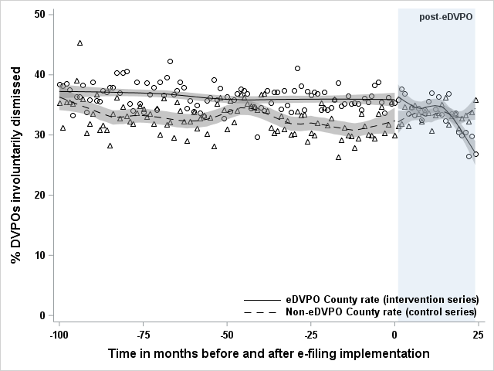
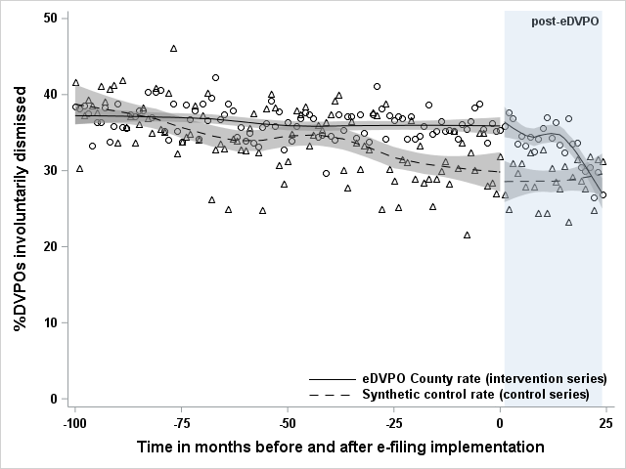
Involuntary dismissals: Sustained decrease
CITS results
Immediate change: -0.09 percentage point decrease (-2.80, 2.98)
Sustained change: -0.36 percentage point decrease (-0.55, -0.18)*
DiD results
Overall change: -3.49 percentage point decrease (-5.00, -1.98)*
SCITS results
Immediate change: 3.37 percentage point increase (-0.49, 7.23)
Sustained change: -0.43 percentage point decrease (-0.68, -0.18)*
SC-DiD results
Overall change: 2.27 percentage point increase (0.11, 4.44)*
Notes:
Finally, involuntary dismissals. Interestingly, the SC-DiD and immediate-term SCITS results show that there is a notable increase in involuntary dismissals post-intervention, whereas in the original DiD and CITS we saw a decrease. The trend line of the synthetic control for this outcome is quite different than for the pooled control and perhaps this is just because counties that looked similar to the intervention counties in terms of their intimate partner violence predictors were not the same counties that had the best pre-intervention trend fit. However, in either case, we find the same result for the sustained change, which is what is most important here.
The fact that we saw the same results with both our hand-selected pooled control group and our synthetic control group means that we have strengthened our valid results here. By creating the synthetic control county, we have better approximated the counterfactual. We can say that even when we are looking at a county with similar demographics and similar predictors of domestic violence, as well as similar pre-intervention trends, we still see this sustained decrease in involuntary dismissals after intervention.

